Slide 1
Tiny Url service

Slide 2
This is technical document that describes the design of Tiny Url service.
The following technologies/software used
Java 1.8
Spring boot v1.2.5
Apache commons v3.4
Google guava v23
CouchBase client v2.7.1
CouchBase server 4/5
Jackson core library
Maven latest version

Slide 3
Requirements
URL shortening system should meet the following requirements:
Given a URL, our service should generate a shorter and unique alias of it.
When users access a short link, service redirects them to the original link.
Links will expire after a standard default timespan.
Users should also be able to specify the expiration time.
The system should be highly available.
URL redirection should happen in real-time with minimal latency.
Shortened links should not be guessable (not predictable).
Our service should also be accessible through REST APIs by other services.

Slide 4
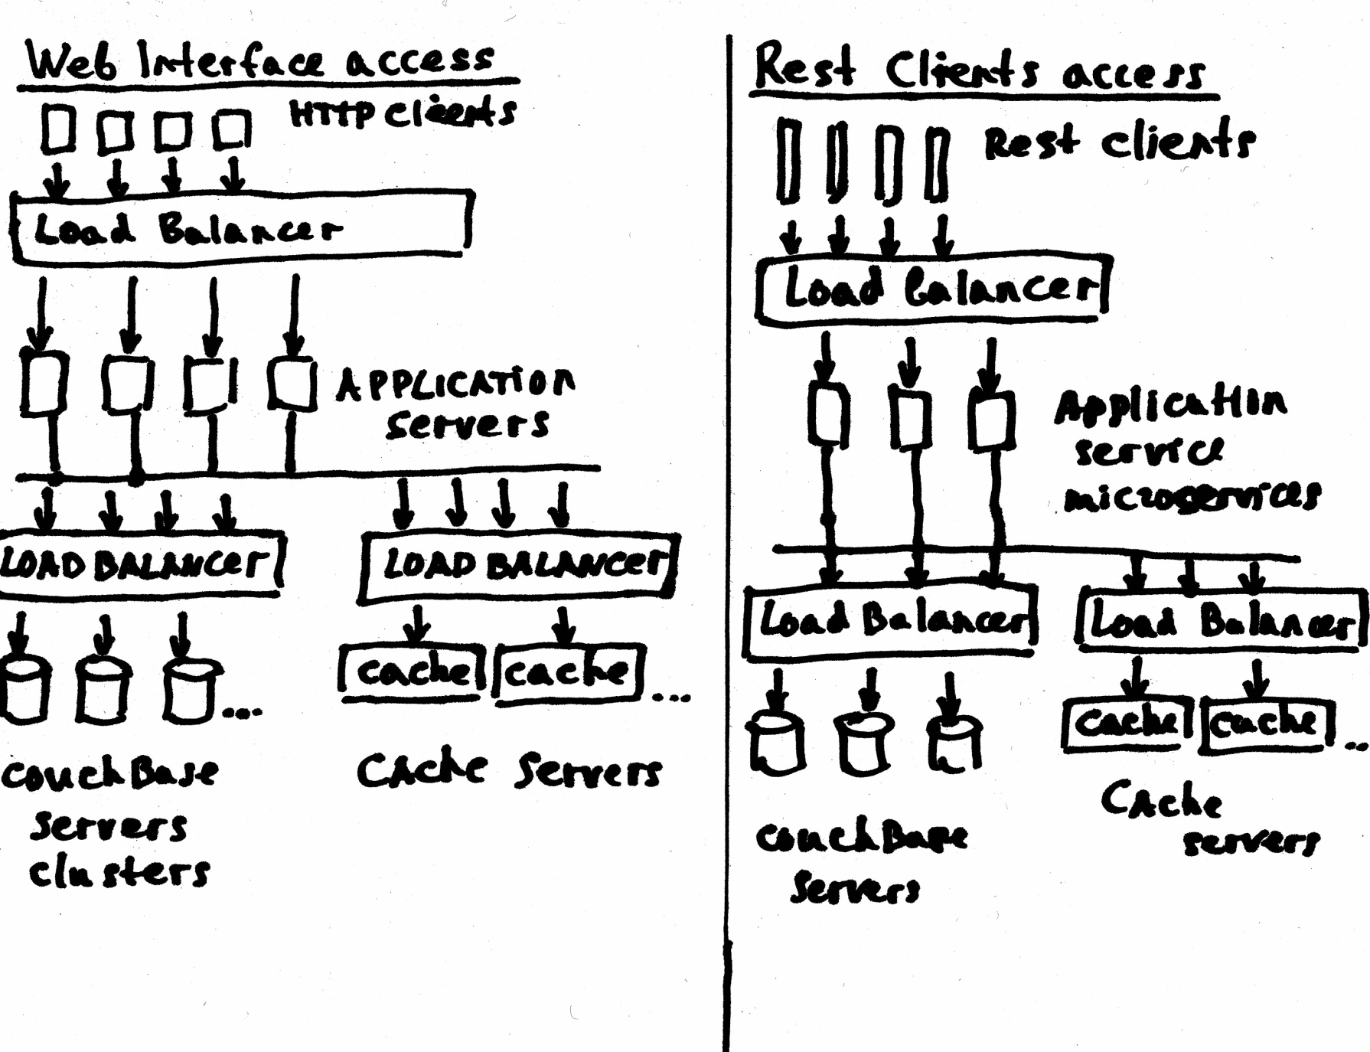
Architectural Design assumptions

Slide 5
Implementation
Implemented 2 endpoints. generate shorten url, consume using shorten url
2 endpoints for Web Http Access and 2 endpoints for Rest Api access
Controller (starting point)
This controller is basically just a pass through class, it will barely contain any logic at all, mostly just pass it data to the Service
and return the correct HTTP Status and objects if needed.
Method used | Implementation method ( Web Interface access )
POST | @RequestMapping(value="/", method = RequestMethod.POST) public ModelAndView shortenUrl(HttpServletRequest httpRequest, @Valid ShortenUrlRequest request, BindingResult bindingResult) { String url = request.getUrl(); ErrorResponse errorResponse = validator.validateUrl(url); processValidationResponse(bindingResult, url, errorResponse); ModelAndView modelAndView = new ModelAndView("shortener"); if (!bindingResult.hasErrors()) { final String id = commonUtils.generateIdFromUrl(url); urlStoreService.storeUrl(id, url); String prefix = commonUtils.buildTinyUrl(httpRequest); modelAndView.addObject("shortenedUrl", prefix + "/" + id); } return modelAndView; }

Slide 6
Method used | Implementation method ( Web Interface access )
GET | @RequestMapping(value = "/{id}", method = RequestMethod.GET) public void redirectToUrl(@PathVariable String id, HttpServletResponse resp) throws Exception { final String url = urlStoreService.findUrlById(id); if (url != null) { resp.addHeader("Location", url); resp.setStatus(HttpServletResponse.SC_MOVED_PERMANENTLY); } else { resp.sendError(HttpServletResponse.SC_NOT_FOUND); } }
Method used | Implementation method ( Rest Client Access )
POST | @RequestMapping( method = RequestMethod.POST, value = "/createTinyUrl", consumes = "application/json", produces = "application/json") public ResponseEntity generateTinyUrl(@RequestBody TinyUrlRequest request) { String url = request.getUrl(); ErrorResponse errorResponse = validator.validateUrl(url); if(errorResponse!=null){ return new ResponseEntity<>(errorResponse, HttpStatus.BAD_REQUEST); } TinyUrlResponse response = urlservice.generateTinyUrl(url); return new ResponseEntity<>(response, HttpStatus.CREATED); }

Slide 7
Method used | Implementation method ( Rest Client Access )
GET | @RequestMapping( method = RequestMethod.GET, value = "/getOriginalUrl/{id}", produces = "application/json") public ResponseEntity getOriginalUrl(@PathVariable String id, HttpServletRequest request) throws Exception { ErrorResponse errorResponse = validator.validateId(id); if(errorResponse!=null){ return new ResponseEntity<>(errorResponse, HttpStatus.BAD_REQUEST); } OriginalUrlResponse origUrlresponse = urlservice.getOriginalUrl(id); return new ResponseEntity<>(origUrlresponse, HttpStatus.FOUND); }

Slide 8
How will shortened URLs be generated?
First of all – we need separated web service from rest service to increase availability and performance.
I selected Google Guava hashing algorithm: murmur3
Reason of usage for this demo project:
murmur3 is well-known hash function, largely used, because of its simplicity, speed, and features (good distribution)
Of course this is a very simple approach. I will discuss real approaches later.
public String generateIdFromUrl(String url){ SecureRandom random = null; try { random = SecureRandom.getInstanceStrong(); } catch (NoSuchAlgorithmException e) { e.printStackTrace(); } int seed = random.nextInt(10000); final String id = Hashing.murmur3_32(seed).hashString(url,StandardCharsets.UTF_8).toString(); return id; }

Slide 9
Analytics or Design considerations
1. Encoding URL in real time system
a separate service needed that utilizes a cluster of id generators that reserve chunks of the id space and refreshing ids as necessary. Probably , expired ids will be moved back to the pool of ids for re-use.
2. Estimation of Load
Tiny Url system will be get(read) and create (write) very heavy.
I don’t know what will be the real load on tiny Url system but
will try to estimate:
If we have 250,000,000 requests to short url per month then
among them: 150,000,000 reads and 100,000,000 writes
requests to get real url per second:
150,000,000 /(30 * 24 * 3600) = ~ 60 get original url requests
requests to create tiny url per second:
100,000,000 /(30 * 24 * 3600) = ~ 39 create tiny url requests.

Slide 10
for 1year: 250,000,000 * 12 = 3 billion
if the size of every message we storing will be 1k or 1000 bytes then
3 billion * 1000 bytes = 3 TB disc storage needed / per year
Cache storage estimate:
If we will keep in cache only 10% of data then we need probably 3Tb * 0.10 = 30 GB
3. Links expiration approach
Because I will use Couchbase NOSQL engine - there is TTL field we can use
upon message creation - is the amount of time until a document expires in Couchbase Server. Couchbase Server periodically removes all items with expiration times that have passed.
In this approach we dont need to design a mechanism to check and delete a such messages.
4. Processing Algorithm to get original url based on tiny url provided:
1. request to get original url received from tiny url
2. service calls cache to check if this url was previously created and if so - get it from cache.
3. if no url in cache then service execute rest call to get such object from CouchBase server
3. if service was not able to find url in cache and Couchbase server then NOT FOUND message returns to client.

Slide 11
5. Processing Algorithm to create tiny url:
1. request to create tiny url received from (original url as parameter)
2. service execute rest call to get next sequence from sequence provider service
3. add new message to Couchbase with key=sequence, url=url and set expiration time user provided,
if expiration time is not provided then set expiration time to default.

